Slide 1


Slide 2
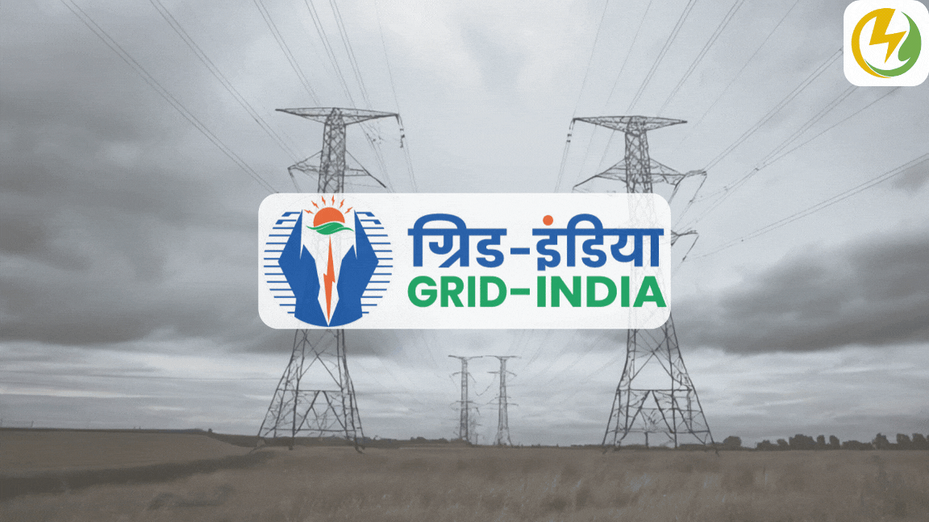
Transmission Fault Line Clustering
Presented By:-
Aditya Ranjan, Anish Kumar & Hanji Ranjan

Slide 3
Problem Statement
The aim of our project is to use machine learning to detect and classify faults.
Faults can be classified into the following categories: line to ground (RG, YG, BG),line to line (RY, YB, RB), double line to ground (RYG, YBG, RBG), triple line (RYB),triple line to ground (RYBG) and faultless.
Different types of faults within a system may not have consistent fault signatures across all occurrences. Instead, a single type of fault can exhibit multiple fault signatures, which can vary based on the specific event or conditions leading to the fault.

Slide 4
Problem Statement
For example, events like tripping or auto-reclosure can have different time sequence graphs even though they cause the same type of fault, making it challenging to effectively classify them.
The primary objective in this context is to develop an effective methodology for identifying and classifying these diverse fault signatures associated with different types of faults.

Slide 5
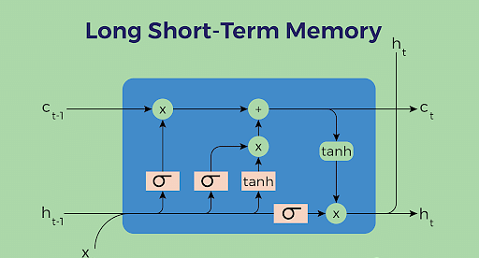
Technology used
LSTM(Long Short-Term Memory)
Reason:-
Temporal Dependency in Voltage Signals.
Feature Extraction from Sequential Data.
Classification Based on Learned Patterns.
Handling Non-Linear Dynamics.
Improving Clustering Accuracy.

Slide 6
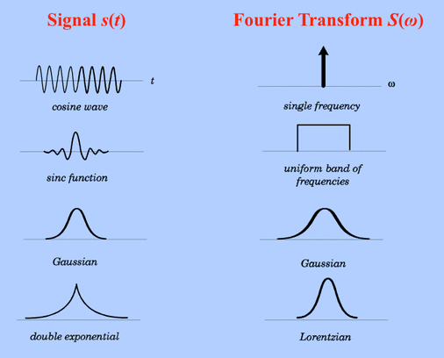
Technology used
Fourier Transformation
Reason:-
Frequency Domain Analysis of Voltage Signals.
Efficient Feature Extraction.
Identification of Periodic and Transient Behavior.
Improving Clustering Accuracy.
Complementary to Time-Domain Analysis.

Slide 7
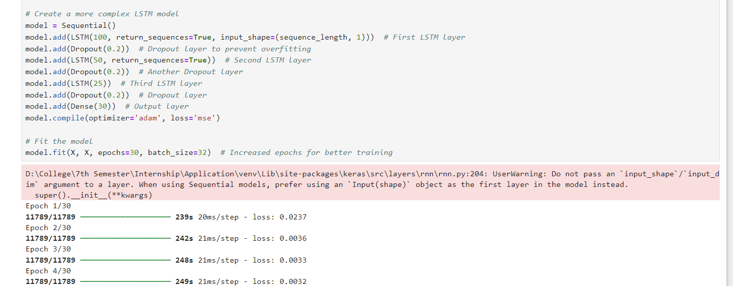
Objective 1
Extract temporal features from sequential voltage data.
Preprocessing: Handling missing values and scaling.
Model architecture: Explain layers (LSTM, Dropout, Dense).
Training details: Sequence length, epochs, batch size.
Fourier Transform

Slide 8
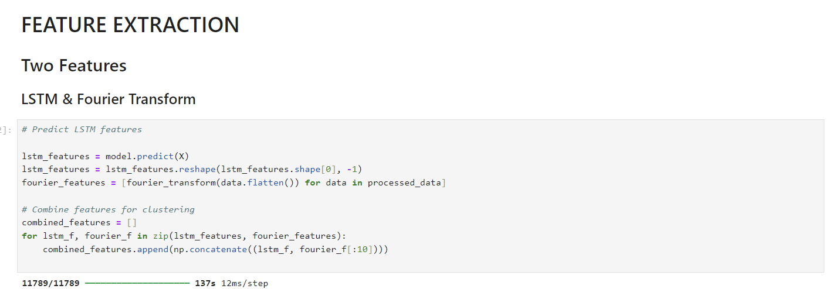
Objective 2
Extract frequency-domain features from voltage data.
Fourier Transform's role in capturing periodic patterns.
Integration with LSTM features.
Feature Combination

Slide 9
Objective 3
Merge LSTM and Fourier features for clustering.
Predict LSTM features.
Apply Fourier Transform to processed data.
Combine both features into a unified representation.
Clustering using K-Means

Slide 10
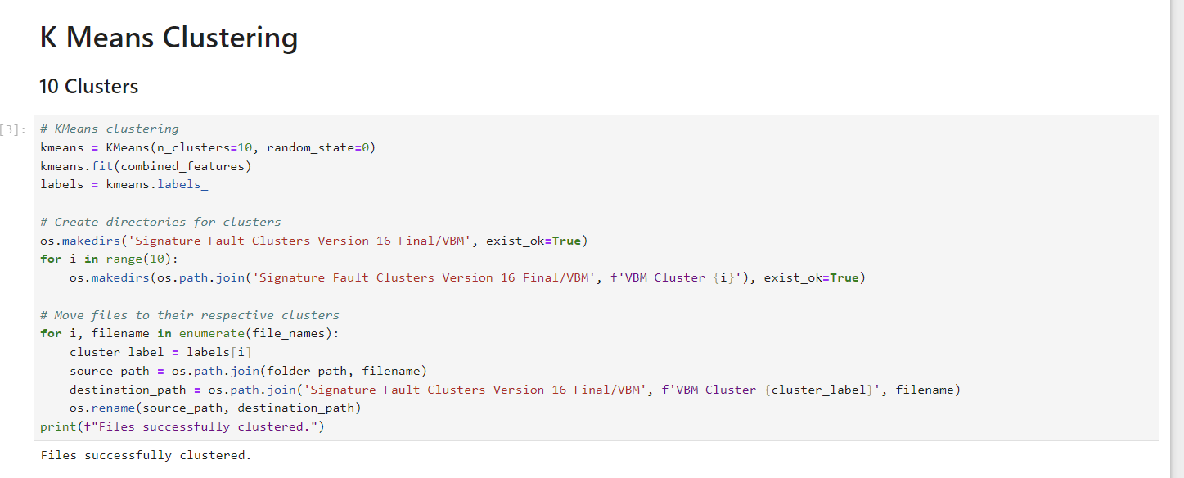
Objective 4
Group voltage fault data into clusters.
Number of clusters: 10.
Explanation of cluster assignment and visualization.
Folder organization for cluster outputs.

Slide 11
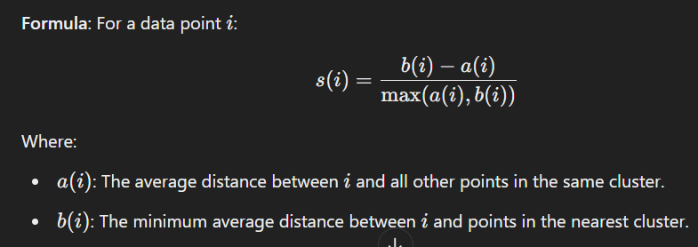
ACCURACY of the Clustering Performance
1. Silhouette Score: 0.3253
Interpretation:
A score of 0.3253 indicates that the clusters are moderately compact and somewhat well-separated.
While it is not very close to the ideal value of 1, it still suggests some structure in the data.
Rating: Moderate (★ ★ ★ ☆ ☆)

Slide 12
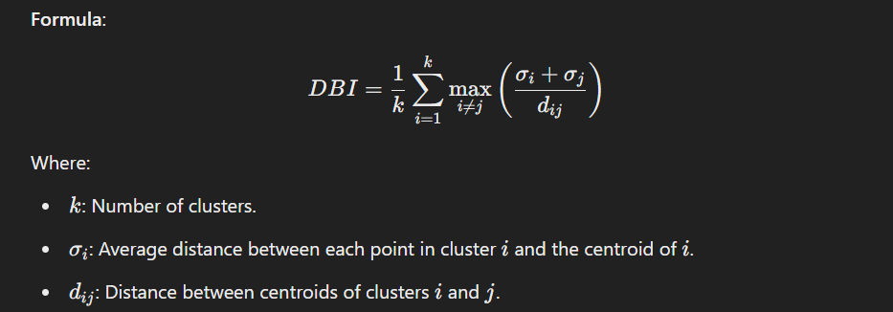
ACCURACY of the Clustering Performance
2. Davies-Bouldin Index: 1.0299
Interpretation:
A score of 1.0299 indicates that the within-cluster scatter is slightly greater than the between-cluster separation.
Lower values are better, with < 1.0 being desirable.
Rating: Slightly Above Average (★ ★ ★ ☆ ☆)

Slide 13
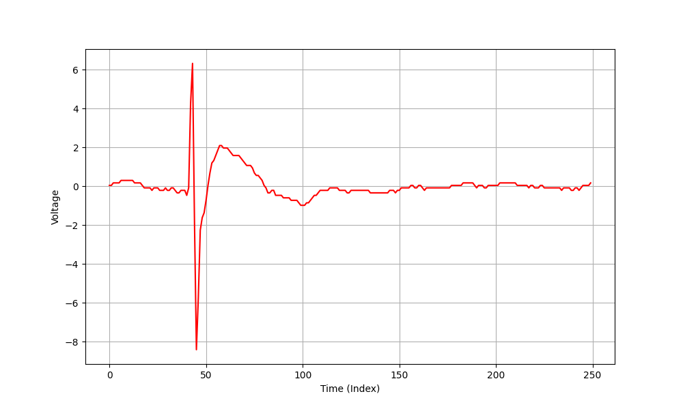
Results
VRM CLUSTER - Spike both up and down

Slide 14
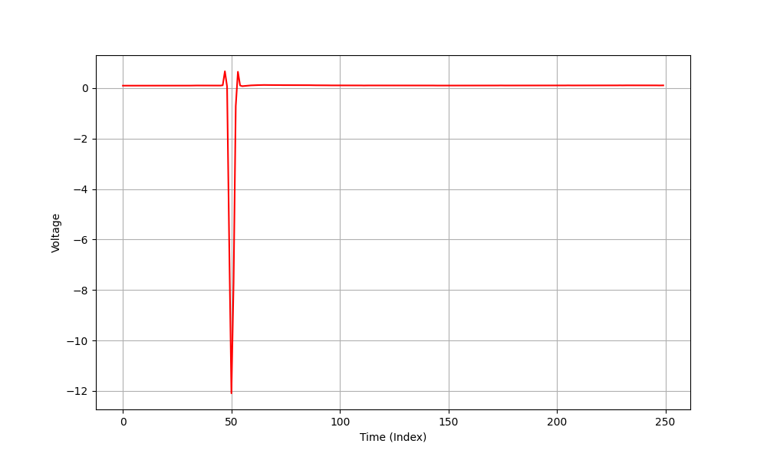
Results
VRM CLUSTER - One spike down

Slide 15
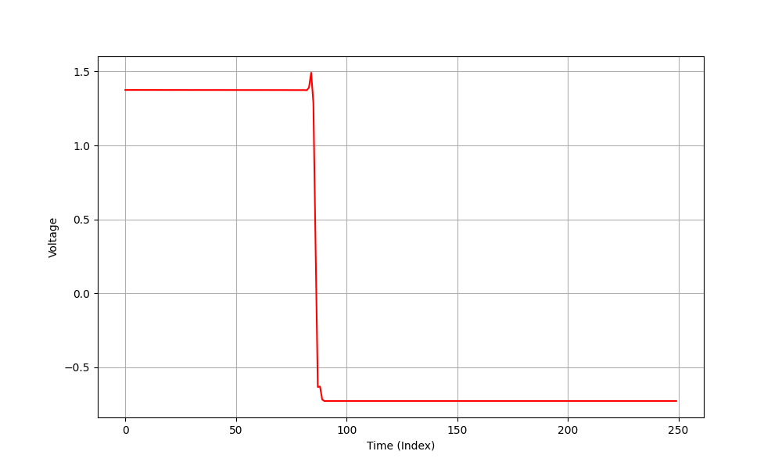
Results
VRM CLUSTER - Tripped down

Slide 16
Thank you

